Slide 1
CSF 2113 Programming for Information Security
Basics of Python Scripting
Revision Slides
Muhammad Humayoun, PhD
Assistant Professor
mhumayoun@hct.ac.ae
Abu Dhabi Men’s College

Slide 2
Development Environments
Jupyter Notebook (Local or Online: Azure Notebook)
Atom
Online Versions
Lot of sites give you opportunity to use python online, no need to install it. Repl is one of them, use this link: https://repl.it/
Spyder
JetBrains PyCharm
Community Version - Lightweight IDE for Python & Scientific development
https://www.jetbrains.com/pycharm/
Microsoft Visual Studio
PyDev -- Eclipse python plugin
http://www.pydev.org/

Slide 3
Hello, World!
Printing:
print ("Hello, World!")
Hello, World!
Taking input:
input (“What is your name? ")
input (“Enter your age ")
Input() returns a string value

Slide 4
Arithmetic Operators
Sum ➔ 1+8
Subtraction ➔ 10 - 2
Multiplication ➔ 2 * 3
Division ➔ 8 / 2
Integer Division ➔ 8//2
Modulus ➔ 8 % 5
Power ➔ 2 ** 3

Slide 5
Assignment Statements
An assignment statement creates a new variable and gives it a value:
>>> message = 'a test message'
>>> n = 17
>>> pi = 3.141592653589793
_{# message has type String}
_{# n has type int}
_{# pi has type float}
>>> n = "Now n references a string"
>>> print(n)
Now n references a string
Variable type may be changed on
the fly

Slide 6
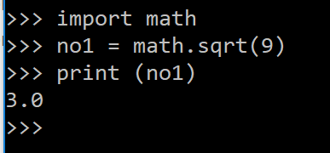
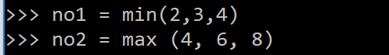
Some Math functions and Evaluating an Expression
math.sqrt(…) function
min( … ), max( … ) functions

Slide 7
Boolean
Boolean type can have two values: True or False
>>> 3 > 4
False
>>> test = (3 > 4)
>>> test
False
>>> b = True
>>> b
True
Expression | Expression in English
X == Y | “X is equal to Y”
X != Y | “X is not equal to Y”
X < Y | “X is less than Y”
X > Y | “X is greater than Y”
X <= Y | “X is less than or equal to Y”
X >= Y | “X is greater than or equal to Y”
not ______ | “Whatever the condition, it’s not True”

Slide 8
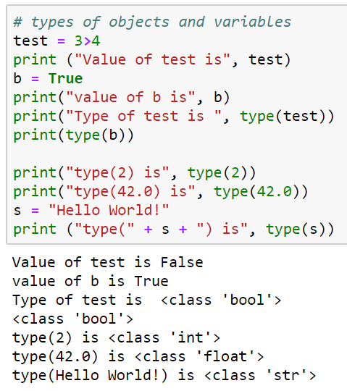
Checking Types
Type function type can be used to check type of a variable or a literal
test is a variable
2, 42.0, “hello” are literals

